Slide 1

Computer Vision in Python Day 1, Part 2/4
Matthieu De Mari

Slide 2
About this lecture
What are images and how is this datatype represented?
What is a pixel and how can its information be interpreted?
What is the spatial dependence property of pixels?
What is the homophily property of pixels?
Why is the linear processing operation failing on images?
What is the convolution operation?
How can we perform image processing using convolutions?
What is padding in convolutions?

Slide 3
About this lecture
What is stride in convolution?
What is dilation in convolution?
How does convolution apply to higher dimensional images?

Slide 4
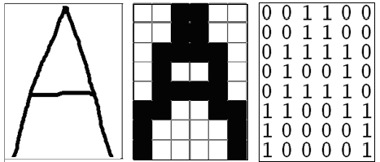
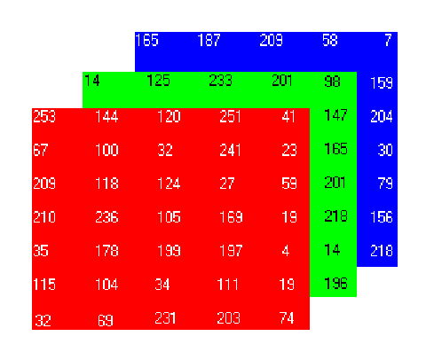
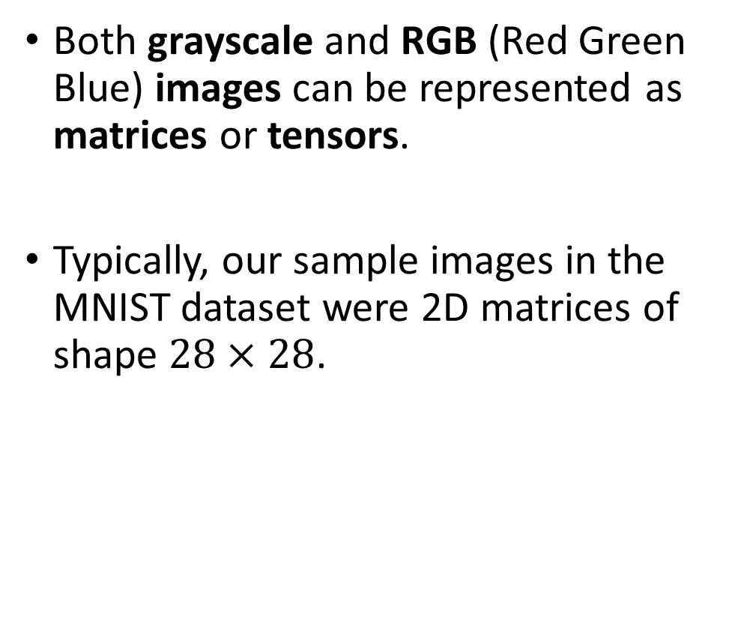
How to encode an image
Both grayscale and RGB (Red Green Blue) images can be represented as matrices or tensors.
Typically, our sample images in the MNIST dataset were 2D matrices of shape $28×28$.

Slide 5
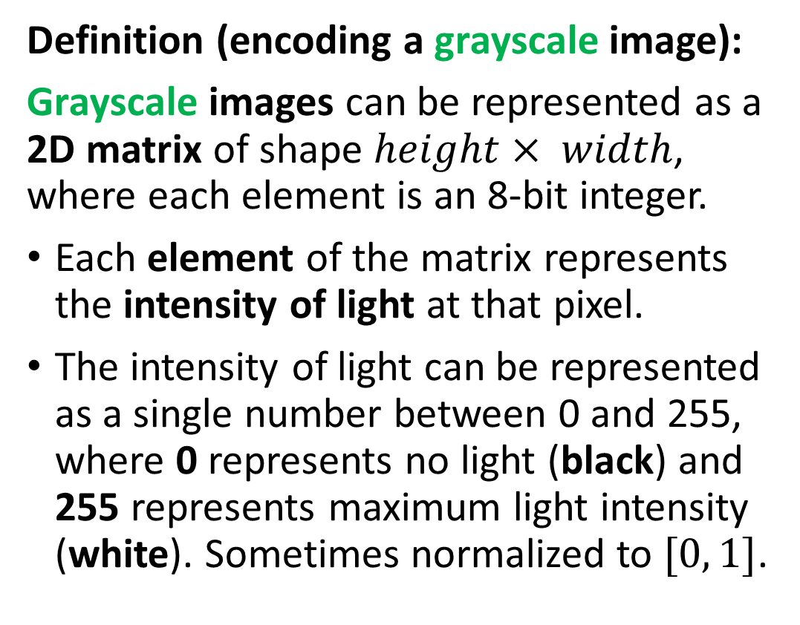
How to encode an image
Definition (encoding a grayscale image):
Grayscale images can be represented as a 2D matrix of shape $height× width$, where each element is an 8-bit integer.
Each element of the matrix represents the intensity of light at that pixel.
The intensity of light can be represented as a single number between 0 and 255, where 0 represents no light (black) and 255 represents maximum light intensity (white). Sometimes normalized to $[0, 1]$.

Slide 6
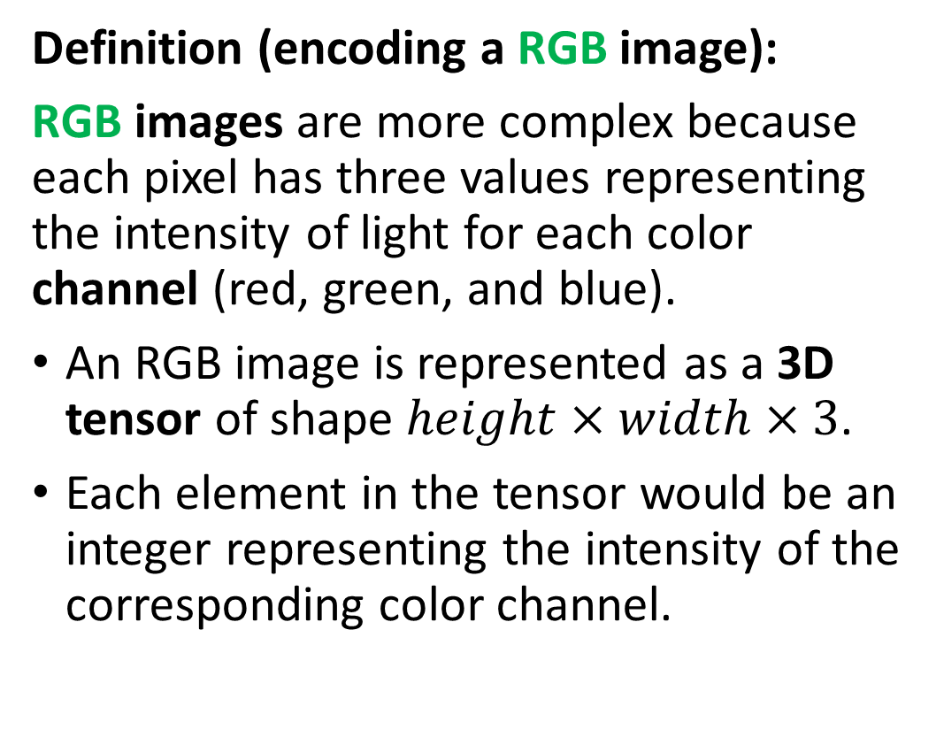
How to encode an image
Definition (encoding a RGB image):
RGB images are more complex because each pixel has three values representing the intensity of light for each color channel (red, green, and blue).
An RGB image is represented as a 3D tensor of shape $height×width×3$.
Each element in the tensor would be an integer representing the intensity of the corresponding color channel.

Slide 7
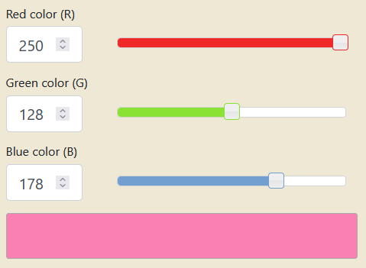
How to encode an image
Combining the red, green and blue values allows to generate any color. Try it!
https://www.rapidtables.com/convert/color/rgb-to-hex.html

Slide 8
The problem with images
Earlier, we played with apartment price prediction using surface (as the first input feature) and distance to MRT (as second input feature).
If I were to swap both input features (distance to MRT becomes first feature, and surface becomes second feature), a human would still be able to understand the information in inputs and predict prices.
But problem in the case of images: What happens if I randomly shuffle the pixels in all input images?
If we shuffled pixels, a human would not be able to tell the number in the image… Would this mean that we lost information about what is inside the image? Or, in other words, that the structure matters?

Slide 9
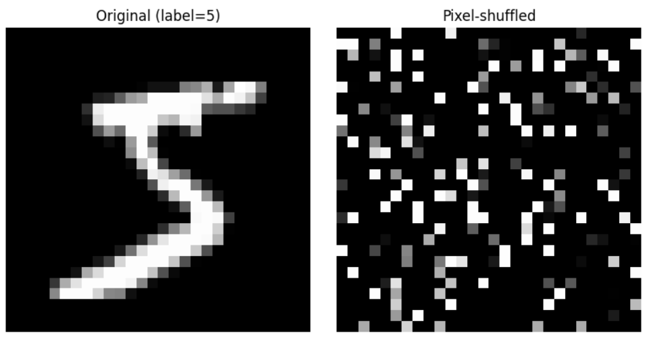
The problem with images
Earlier, we played with apartment price prediction using surface (as the first input feature) and distance to MRT (as second input feature).
If I were to swap both input features (distance to MRT becomes first feature, and surface becomes second feature), a human would still be able to understand the information in inputs and predict prices.
But problem in the case of images: What happens if I randomly shuffle the pixels in all input images?
If we shuffled pixels, a human would not be able to tell the number in the image… Would this mean that we lost information about what is inside the image? Or, in other words, that the structure matters?

Slide 10
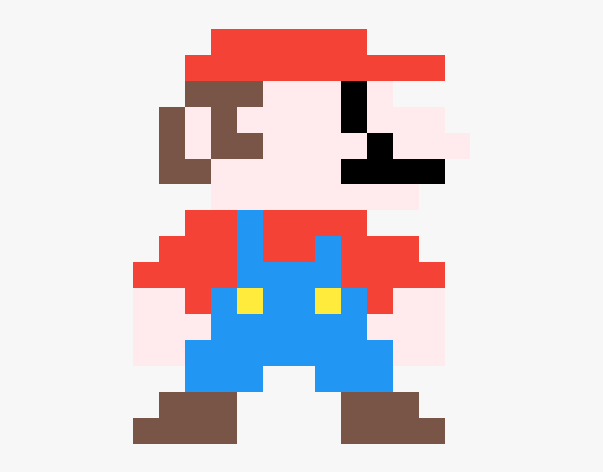
The problem with images: another example
Each element in a Greyscale matrix or RGB matrix corresponds to a pixel, representing something in the image.
The problem, however, is that it is often impossible to guess the meaning of a given pixel, by looking at this pixel alone.

Slide 11
The problem with images: another example
Can you guess what this pixel represents and what object it belongs to?
Flower petal
Piece of clothing
Skin of a human person
Feather of a bird

Slide 12
The problem with images: another example
What if I show you some neighbouring pixels now?
Flower petal
Piece of clothing
Skin of a human person
Feather of a bird

Slide 13
The problem with images: another example
What if I show you MORE neighbouring pixels now?
Flower petal
Piece of clothing
Skin of a human person
Feather of a bird

Slide 14
The problem with images: another example
What if I show you MORE neighbouring pixels now?
Flower petal
Piece of clothing
Skin of a human person
Feather of a bird

Slide 15
The spatial dependence property
Definition (the spatial dependence property of pixels):
The spatial dependence property of pixels states that the meaning or interpretation of a single pixel in an image can often only be understood in the context of the pixels around it.
This is because the information in a single pixel is often not enough to describe the complete picture, or even just the pixel itself.
The structure of the image (i.e. the relationship between a given pixel and its neighbouring pixels) is necessary to provide a full understanding of this particular pixel, or even the image as a whole.
Images have “structure” and this structure contains information, which is something we observed in the Mario pixel art example.

Slide 16
The homophily property
Definition (the homophily property of pixels):
Homophily in images refers to the phenomenon where pixels that are close to each other in the image tend to have similar properties (such as color, texture, or intensity).
For example, pixels that are close to each other and have a similar blue color can often be grouped together and be considered part of the sky region. Identifying parts of the image where the homophily property breaks (i.e. drastic changes in pixel color) is how we recognize objects in the image.
This property is a key factor in image processing and computer vision algorithms, as it provides a way to segment images into meaningful regions and perform tasks like object recognition and image classification.

Slide 17
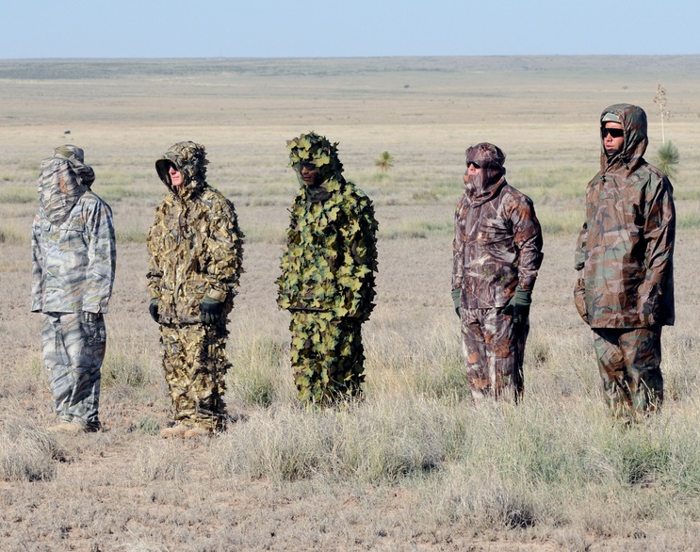
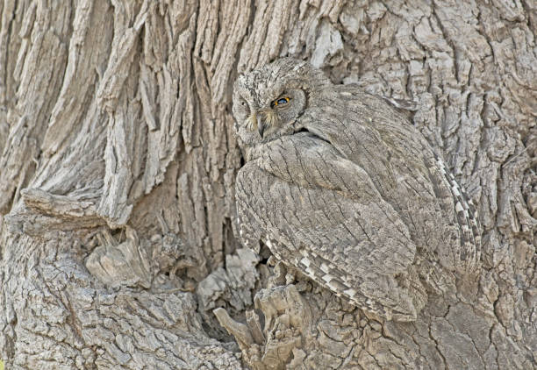
The homophily property
Note: The whole point of camouflage is to make it difficult to separate pixels from objects of interest and background, by having objects use similar colors as their backgrounds (i.e. homophily!)
Definition (the homophily property of pixels):
Homophily in images refers to the phenomenon where pixels that are close to each other in the image tend to have similar properties (such as color, texture, or intensity).
For example, pixels that are close to each other and have a similar blue color can often be grouped together and be considered part of the sky region. Identifying parts of the image where the homophily property breaks (i.e. drastic changes in pixel color) is how we recognize objects in the image.
This property is a key factor in image processing and computer vision algorithms, as it provides a way to segment images into meaningful regions and perform tasks like object recognition and image classification.

Slide 18
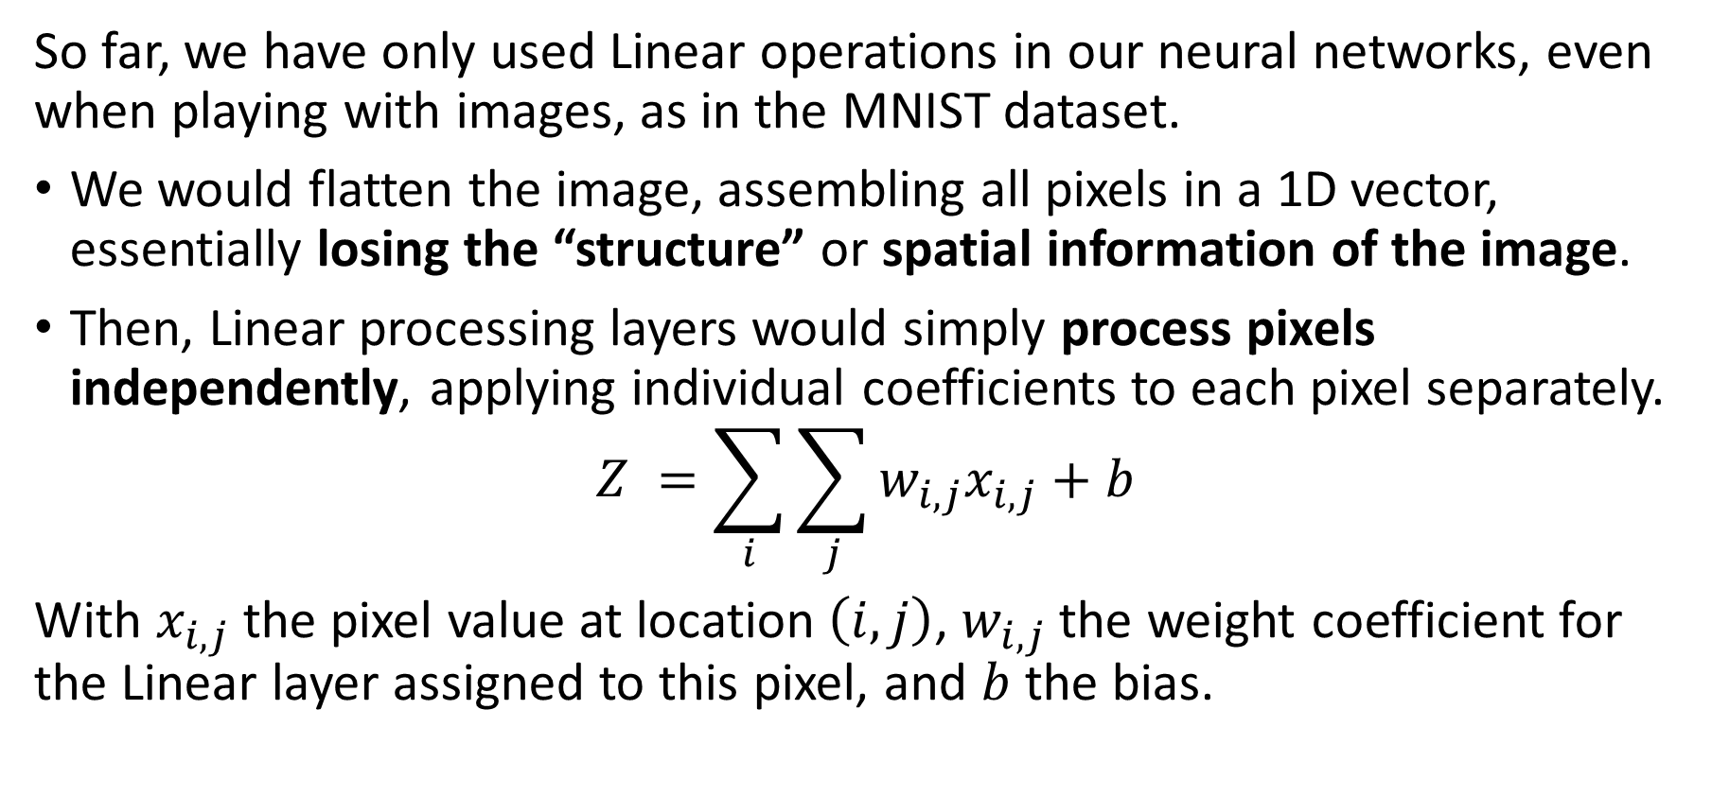
The problem with Linear processing
So far, we have only used Linear operations in our neural networks, even when playing with images, as in the MNIST dataset.
We would flatten the image, assembling all pixels in a 1D vector, essentially losing the “structure” or spatial information of the image.
Then, Linear processing layers would simply process pixels independently, applying individual coefficients to each pixel separately.
$$Z =\sum_{i}{\sum_{j}{w_{i,j}x_{i,j}+b}}$$
With $x_{i,j}$ the pixel value at location $\left(i,j\right)$, $w_{i,j}$ the weight coefficient for the Linear layer assigned to this pixel, and $b$ the bias.

Slide 19
The problem with Linear processing
Linear layers are not great at processing images because they do not take into account the spatial dependence of pixels.
Pixels in images are typically related to each other in a spatial manner, i.e. the meaning of a pixel depends on the neighbour pixels.
Unfortunately, linear models would assume each pixel is independent of the others and process them independently, which is not correct.
As a result, linear layers can miss important spatial relationships between pixels. This can, in turn, result in poor image representation and interpretation.
→ Need for a more specific processing operation for images, to use in place of the Linear one!

Slide 20
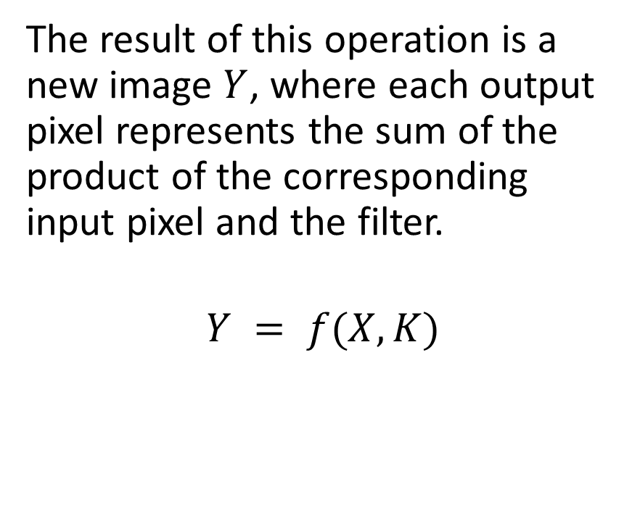
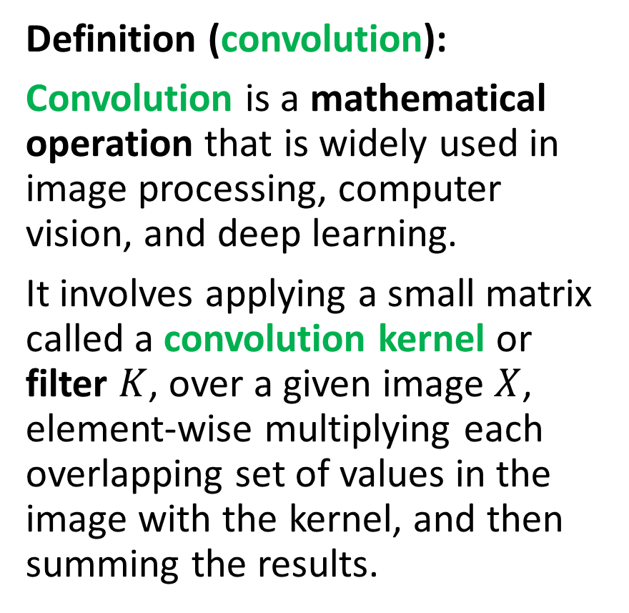
Introducing convolution!
Definition (convolution):
Convolution is a mathematical operation that is widely used in image processing, computer vision, and deep learning.
It involves applying a small matrix called a convolution kernel or filter $K$, over a given image $X$, element-wise multiplying each overlapping set of values in the image with the kernel, and then summing the results.
The result of this operation is a new image $Y$, where each output pixel represents the sum of the product of the corresponding input pixel and the filter.
$$Y = f(X, K)$$

Slide 21
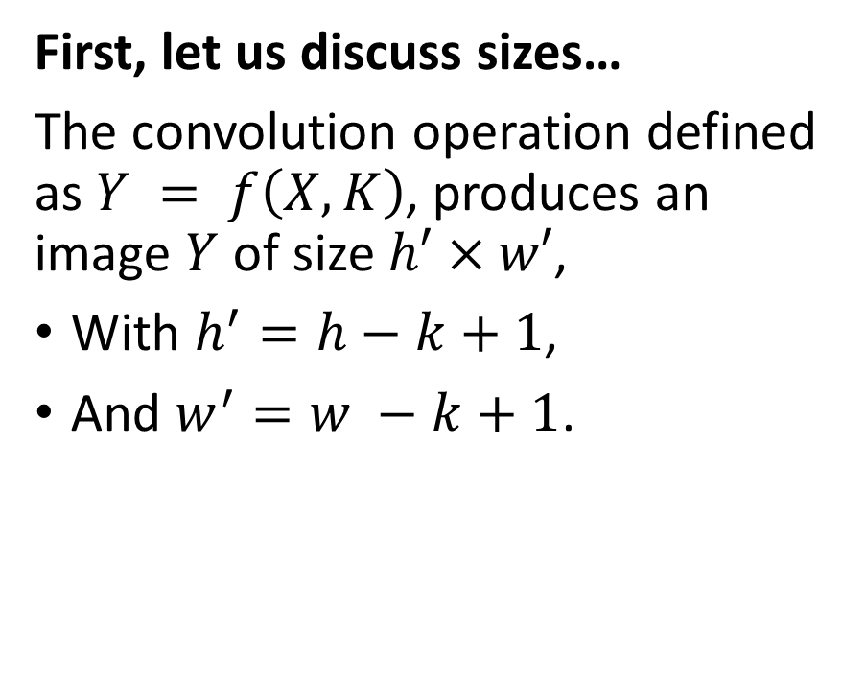
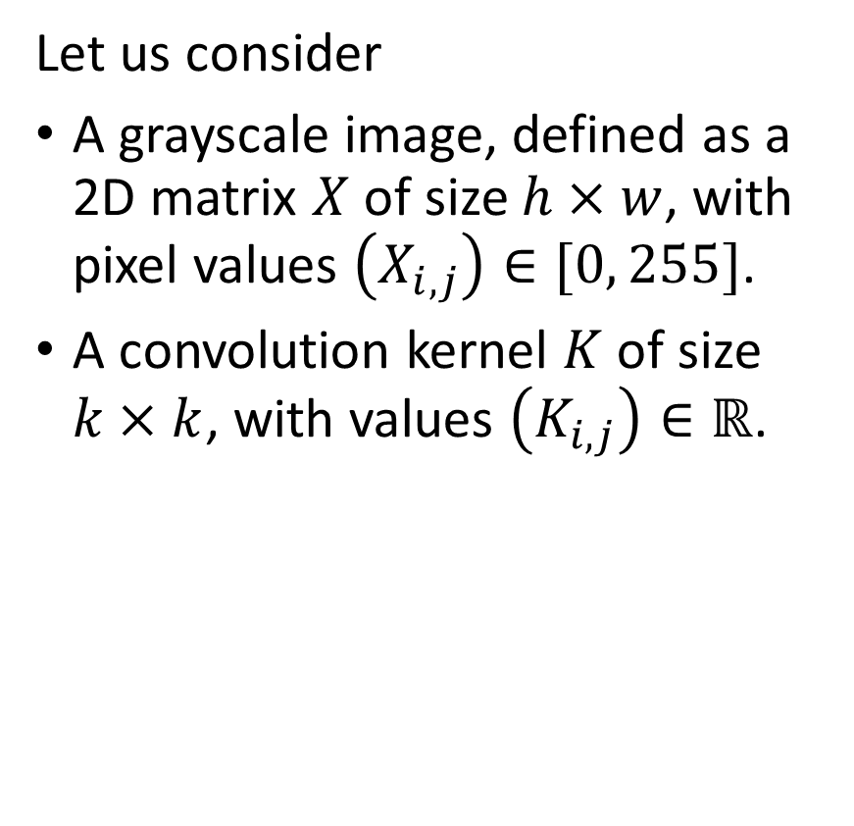
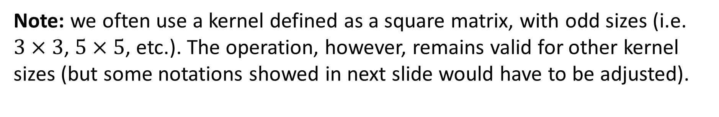
Introducing convolution!
Let us consider
A grayscale image, defined as a 2D matrix $X$ of size $h×w$, with pixel values $\left(X_{i,j}\right)∈[0, 255]$.
A convolution kernel $K$ of size $k×k$, with values $\left(K_{i,j}\right)∈ℝ$.
First, let us discuss sizes…
The convolution operation defined as $Y = f\left(X, K\right)$, produces an image $Y$ of size $h′×w′$,
With $h^{′}=h−k+1$,
And $w^{′}=w −k+1$.
Note: we often use a kernel defined as a square matrix, with odd sizes (i.e. $3×3$, $5×5$, etc.). The operation, however, remains valid for other kernel sizes (but some notations showed in next slide would have to be adjusted).

Slide 22

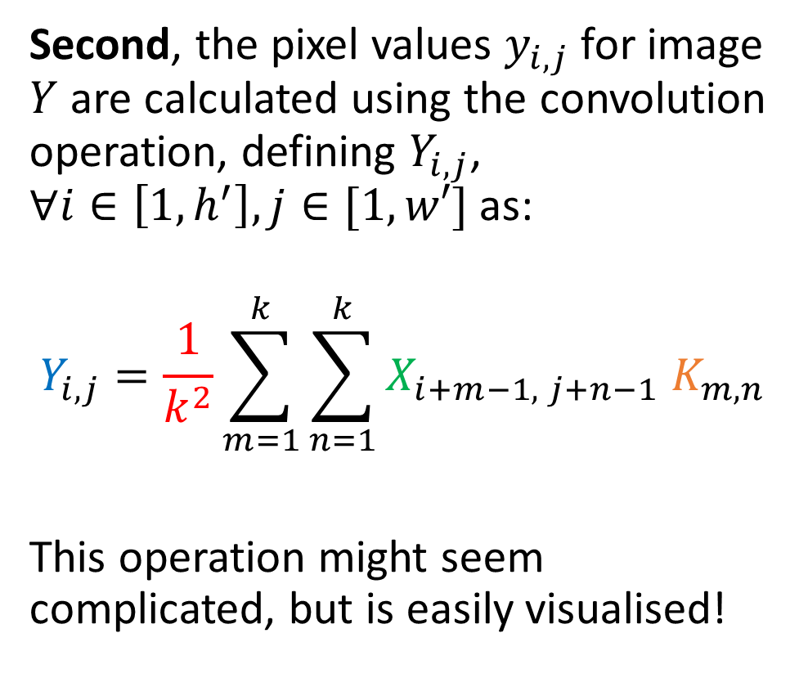


Introducing convolution!
1 | 2 | 4 | 2 | 1
4 | 7 | 3 | 2 | 1
4 | 5 | 2 | 3 | 1
2 | 1 | 7 | 8 | 4
3 | 2 | 4 | 7 | 8
X is 5 by 5
K is 3 by 3
Y is therefore 3 by 3.
(5-3+1 = 3)
$$X$$
Second, the pixel values $y_{i,j}$for image $Y$ are calculated using the convolution operation, defining $Y_{i,j}$, $∀i∈\left[1, h^{′}\right], j∈[1,w′]$ as:
$$Y_{i,j}=\frac{1}{k^{2}}\sum_{m=1}^{k}{\sum_{n=1}^{k}{X_{i+m−1, j+n−1} K_{m,n}}}$$
This operation might seem complicated, but is easily visualised!
1 | 0 | 1
0 | 2 | 1
1 | 0 | 1
$$K$$
… | … | …
… | … | …
… | … | …
$$Y$$

Slide 23
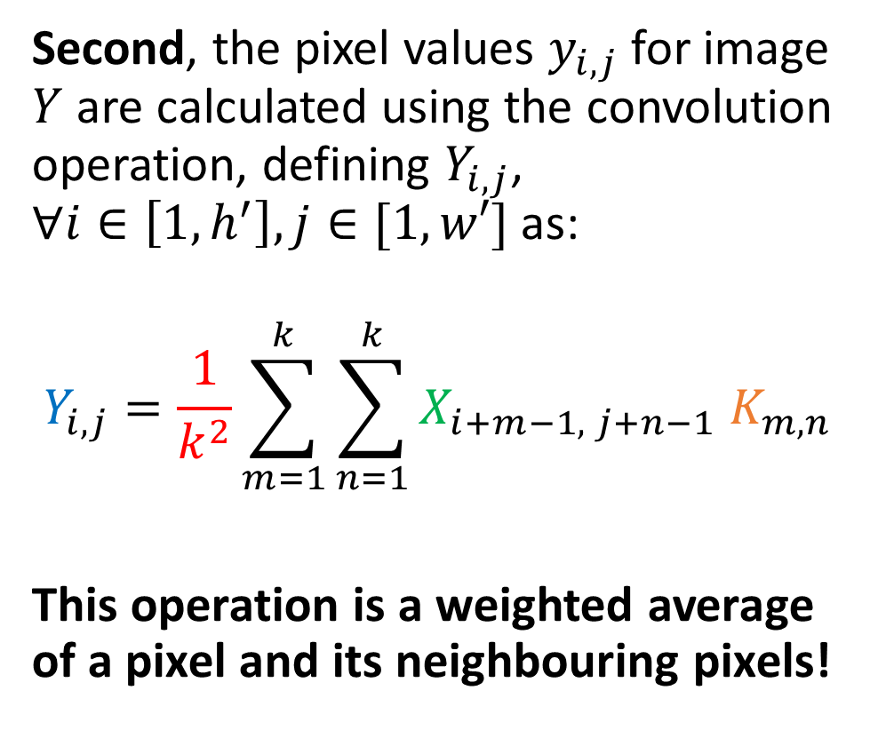
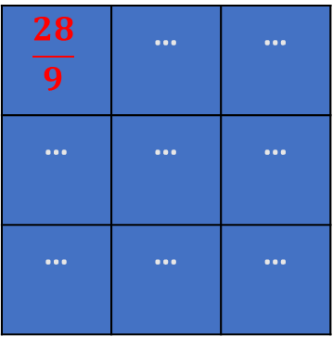
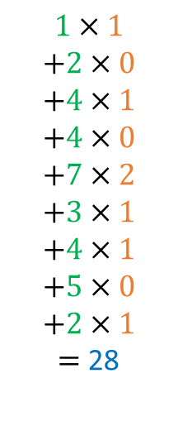
Introducing convolution!
1 | 2 | 4 | 2 | 1
4 | 7 | 3 | 2 | 1
4 | 5 | 2 | 3 | 1
2 | 1 | 7 | 8 | 4
3 | 2 | 4 | 7 | 8
$$1×1$$
$$+2×0$$
$$+4×1$$
$$+4×0$$
$$+7×2$$
$$+3×1$$
$$+4×1$$
$$+5×0$$
$$+2×1$$
$=$ 28
$$X$$
Second, the pixel values $y_{i,j}$for image $Y$ are calculated using the convolution operation, defining $Y_{i,j}$, $∀i∈\left[1, h^{′}\right], j∈[1,w′]$ as:
$$Y_{i,j}=\frac{1}{k^{2}}\sum_{m=1}^{k}{\sum_{n=1}^{k}{X_{i+m−1, j+n−1} K_{m,n}}}$$
This operation is a weighted average of a pixel and its neighbouring pixels!
1 | 0 | 1
0 | 2 | 1
1 | 0 | 1
$$K$$
$$\frac{28}{9}$$ | … | …
… | … | …
… | … | …
$$Y$$

Slide 24
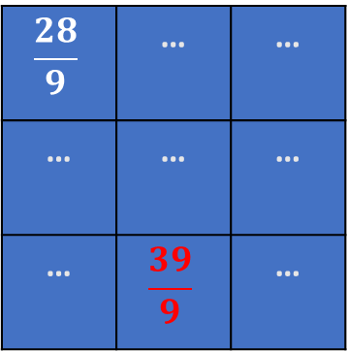
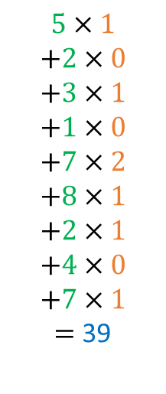
Introducing convolution!
1 | 2 | 4 | 2 | 1
4 | 7 | 3 | 2 | 1
4 | 5 | 2 | 3 | 1
2 | 1 | 7 | 8 | 4
3 | 2 | 4 | 7 | 8
$$5×1$$
$$+2×0$$
$$+3×1$$
$$+1×0$$
$$+7×2$$
$$+8×1$$
$$+2×1$$
$$+4×0$$
$$+7×1$$
$=$ 39
$$X$$
Second, the pixel values $y_{i,j}$for image $Y$ are calculated using the convolution operation, defining $Y_{i,j}$, $∀i∈\left[1, h^{′}\right], j∈[1,w′]$ as:
$$Y_{i,j}=\frac{1}{k^{2}}\sum_{m=1}^{k}{\sum_{n=1}^{k}{X_{i+m−1, j+n−1} K_{m,n}}}$$
This operation is a weighted average of a pixel and its neighbouring pixels!
1 | 0 | 1
0 | 2 | 1
1 | 0 | 1
$$K$$
$$\frac{28}{9}$$ | … | …
… | … | …
… | $$\frac{39}{9}$$ | …
$$Y$$

Slide 25

Introducing convolution!
1 | 2 | 4 | 2 | 1
4 | 7 | 3 | 2 | 1
4 | 5 | 2 | 3 | 1
2 | 1 | 7 | 8 | 4
3 | 2 | 4 | 7 | 8
$$5×1$$
$$+2×0$$
$$+3×1$$
$$+1×0$$
$$+7×2$$
$$+8×1$$
$$+2×1$$
$$+4×0$$
$$+7×1$$
$=$ 39
$$X$$
Second, the pixel values $y_{i,j}$for image $Y$ are calculated using the convolution operation, defining $Y_{i,j}$, $∀i∈\left[1, h^{′}\right], j∈[1,w′]$ as:
$$Y_{i,j}=\frac{1}{k^{2}}\sum_{m=1}^{k}{\sum_{n=1}^{k}{X_{i+m−1, j+n−1} K_{m,n}}}$$
1 | 0 | 1
0 | 2 | 1
1 | 0 | 1
$$K$$
$$\frac{28}{9}$$ | … | …
… | … | …
… | $$\frac{39}{9}$$ | …
$$Y$$
Note: Sometimes, the normalization term is removed and we may instead normalize the kernel (ensuring elements in kernel matrix sum up to 1), or not.

Slide 26
Introducing convolution!
1 | 2 | 4 | 2 | 1
4 | 7 | 3 | 2 | 1
4 | 5 | 2 | 3 | 1
2 | 1 | 7 | 8 | 4
3 | 2 | 4 | 7 | 8
$$5×1$$
$$+2×0$$
$$+3×1$$
$$+1×0$$
$$+7×2$$
$$+8×1$$
$$+2×1$$
$$+4×0$$
$$+7×1$$
$=$ 39
$$X$$
Second, the pixel values $y_{i,j}$for image $Y$ are calculated using the convolution operation, defining $Y_{i,j}$, $∀i∈\left[1, h^{′}\right], j∈[1,w′]$ as:
$$Y_{i,j}=\frac{1}{k^{2}}\sum_{m=1}^{k}{\sum_{n=1}^{k}{X_{i+m−1, j+n−1} K_{m,n}}}$$
1 | 0 | 1
0 | 2 | 1
1 | 0 | 1
$$K$$
$$\frac{28}{9}$$ | … | …
… | … | …
… | $$\frac{39}{9}$$ | …
$$Y$$
→ At the end of the day, convolution is just another type of matrix multiplication!

Slide 27
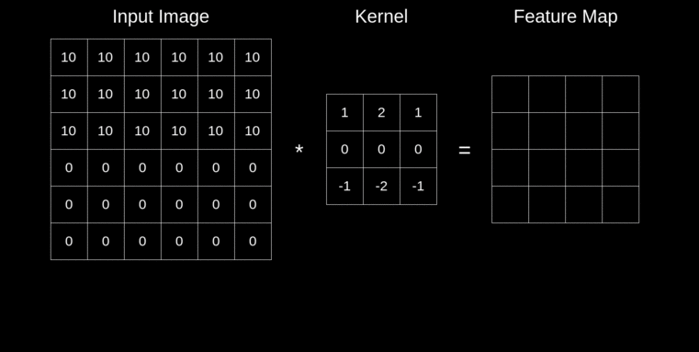
An animated visualisation of Convolution

Slide 28
Convolution and Image Processing courses
Convolution is a key mathematical operation that is widely used in computer vision and image processing to apply a wide range of transformations on an image (enhancing contrast, blurring, edge detection, Instagram filters, etc).
If Computer Vision is a direction that interests you, I would strongly advise to take a course on Image Processing (with implementations in OpenCV, Photoshop, etc.) during your continued learning.
For instance: https://www.udemy.com/course/digital-image-processing-from-ground-up-in-python/

Slide 29
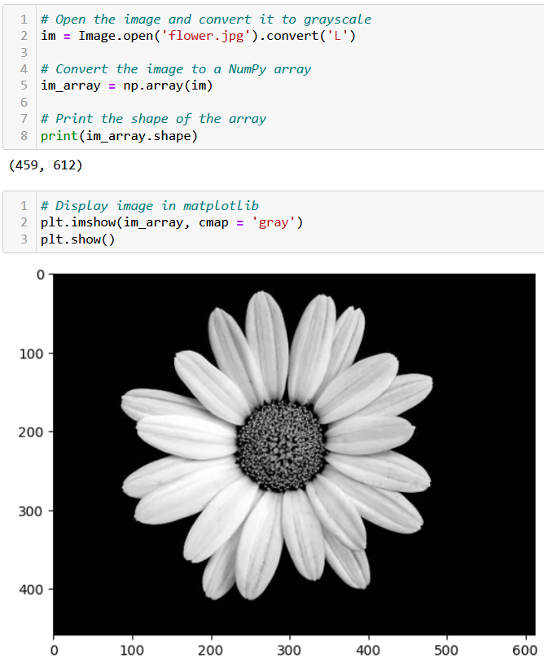
Testing convolution on images
Let us try the convolution operation on images to see their effect.
First, we need a greyscale image.

Slide 30
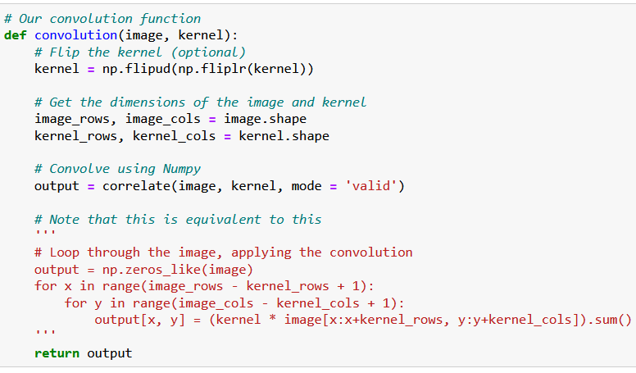
Testing convolution on images
Let us try the convolution operation on images to see their effect.
First, we need a greyscale image.
Second, we need a convolution function.

Slide 31
Testing convolution on images
What is the purpose of flipping the kernel?
Optional, but in short, flipping the kernel has mathematical and practical advantages that make it a common practice in deep learning.
(It has to do with commutativity, signal processing, the Fourier Transform and the convolution theorem, 100% out-of-scope).
https://stackoverflow.com/questions/45152473/why-is-the-convolutional-filter-flipped-in-convolutional-neural-networks

Slide 32
Testing convolution on images
Let us try the convolution operation on images to see their effect.
First, we need a greyscale image.
Second, we need a convolution function.
The magic for the transformation then happens when deciding which kernel to use.

Slide 33
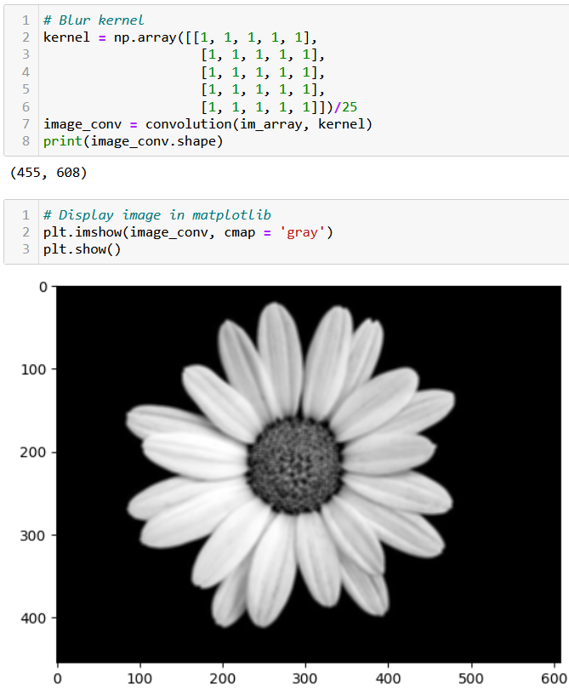
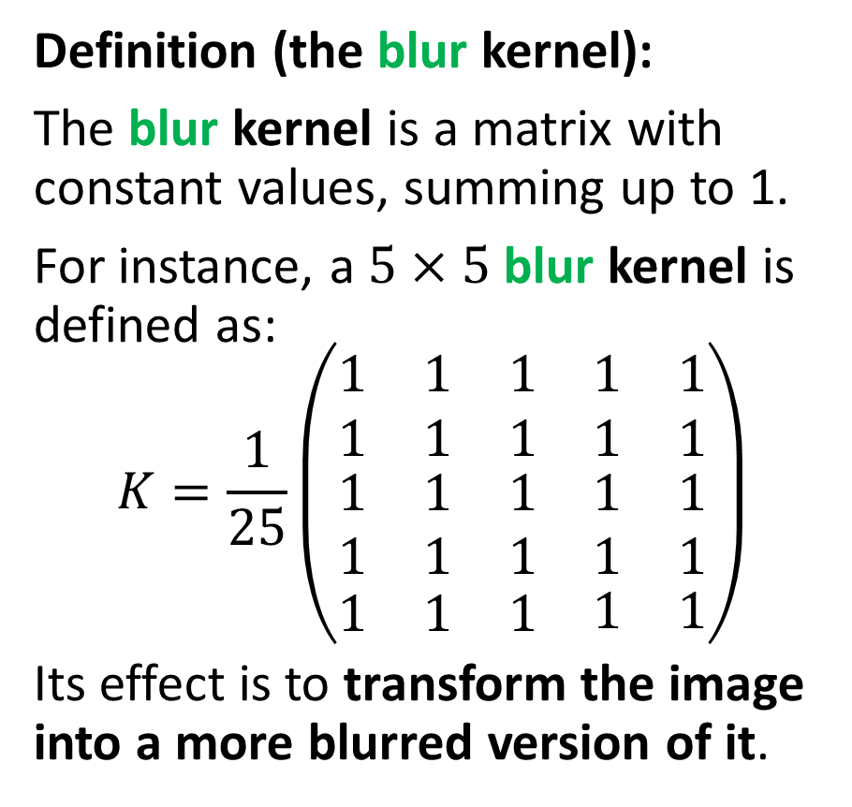
Testing convolution on images
Definition (the blur kernel):
The blur kernel is a matrix with constant values, summing up to 1.
For instance, a $5×5$ blur kernel is defined as:
$$K=\frac{1}{25}\left(\begin{matrix}\begin{matrix}1 & 1 & 1 \\ 1 & 1 & 1\end{matrix} & \begin{matrix}1 \\ 1\end{matrix} & \begin{matrix}1 \\ 1\end{matrix} \\ \begin{matrix}1 & 1 & 1 \\ 1 & 1 & 1\end{matrix} & \begin{matrix}1 \\ 1\end{matrix} & \begin{matrix}1 \\ 1\end{matrix} \\ \begin{matrix}1 & 1 & 1\end{matrix} & 1 & 1\end{matrix}\right)$$
Its effect is to transform the image into a more blurred version of it.

Slide 35
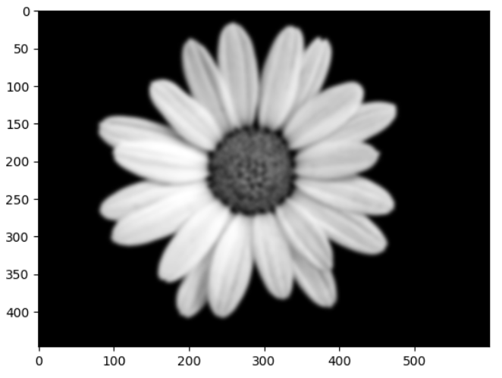
Can be repeated multiple times to increase the blur effect!

Slide 36
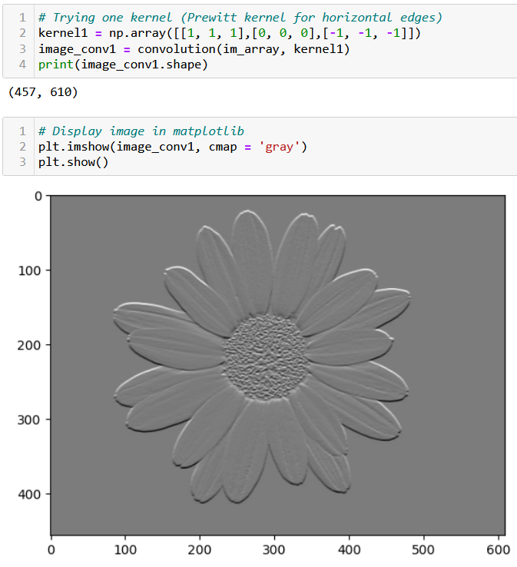
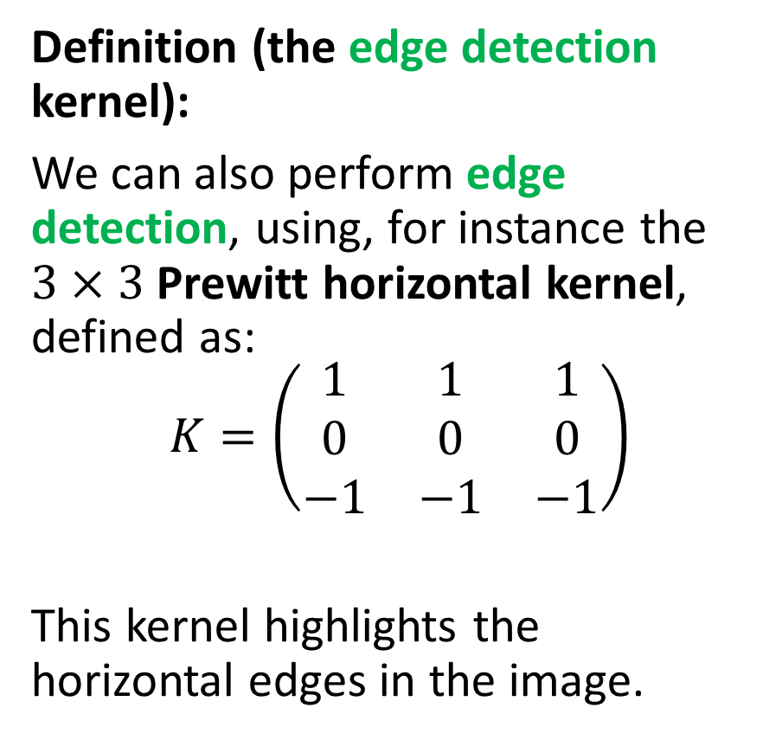
Testing convolution on images
Definition (the edge detection kernel):
We can also perform edge detection, using, for instance the $3×3$ Prewitt horizontal kernel, defined as:
$$K=\left(\begin{matrix}1 & 1 & 1 \\ 0 & 0 & 0 \\ −1 & −1 & −1\end{matrix}\right)$$
This kernel highlights the horizontal edges in the image.

Slide 37
Testing convolution on images
Definition (the edge detection kernel):
This kernel produces
a value close to zero when all pixels are similar,
and a non-zero value if there is a drastic change of values in the pixel and its neighbouring pixels.
Typically, it detects scenarios where the homophily property does not hold (i.e. an edge!).

Slide 39
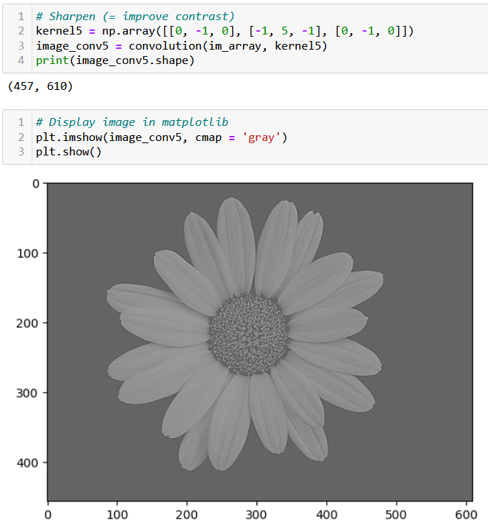
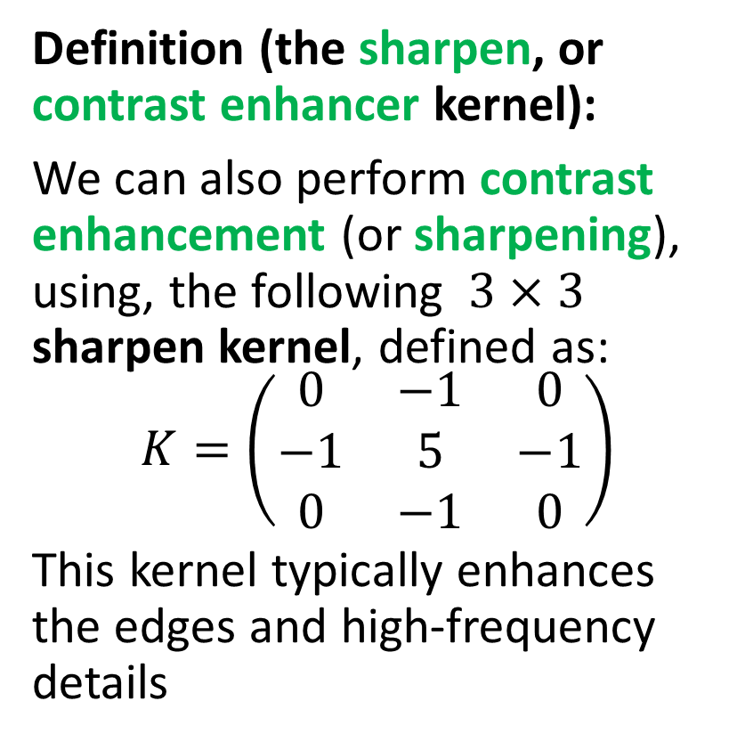
Testing convolution on images
Definition (the sharpen, or contrast enhancer kernel):
We can also perform contrast enhancement (or sharpening), using, the following $3×3$ sharpen kernel, defined as:
$$K=\left(\begin{matrix}0 & −1 & 0 \\ −1 & 5 & −1 \\ 0 & −1 & 0\end{matrix}\right)$$
This kernel typically enhances the edges and high-frequency details

Slide 41
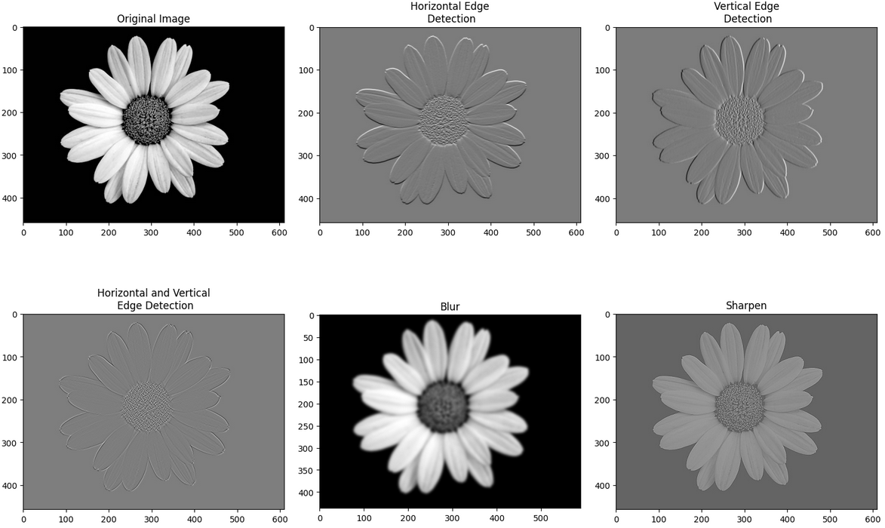
Many transformation kernels exist

Slide 42
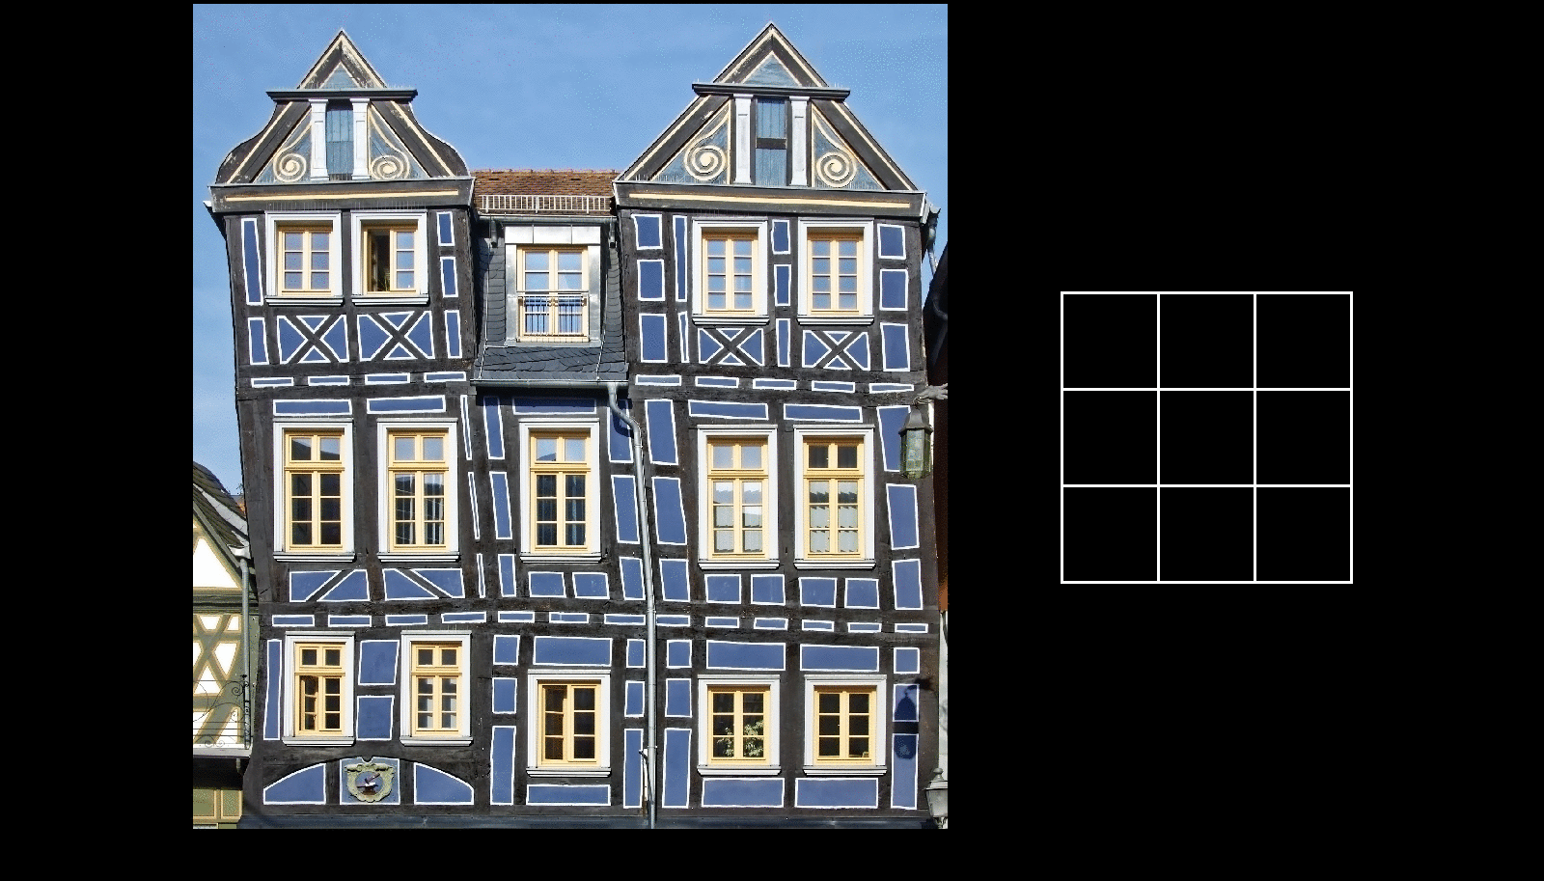
More on convolution kernels and their effects

Slide 43
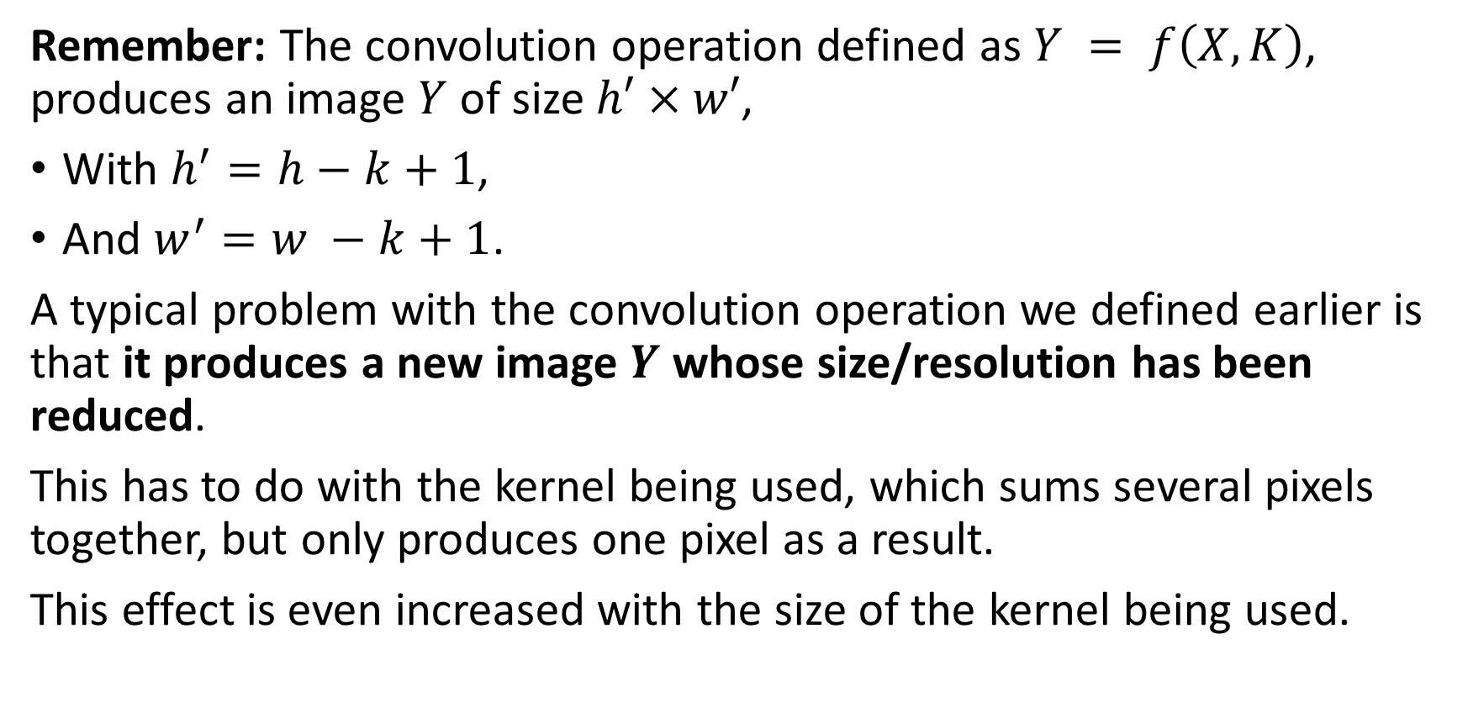
Downsizing
Remember: The convolution operation defined as $Y = f\left(X, K\right)$, produces an image $Y$ of size $h′×w′$,
With $h^{′}=h−k+1$,
And $w^{′}=w −k+1$.
A typical problem with the convolution operation we defined earlier is that it produces a new image $Y$ whose size/resolution has been reduced.
This has to do with the kernel being used, which sums several pixels together, but only produces one pixel as a result.
This effect is even increased with the size of the kernel being used.

Slide 44
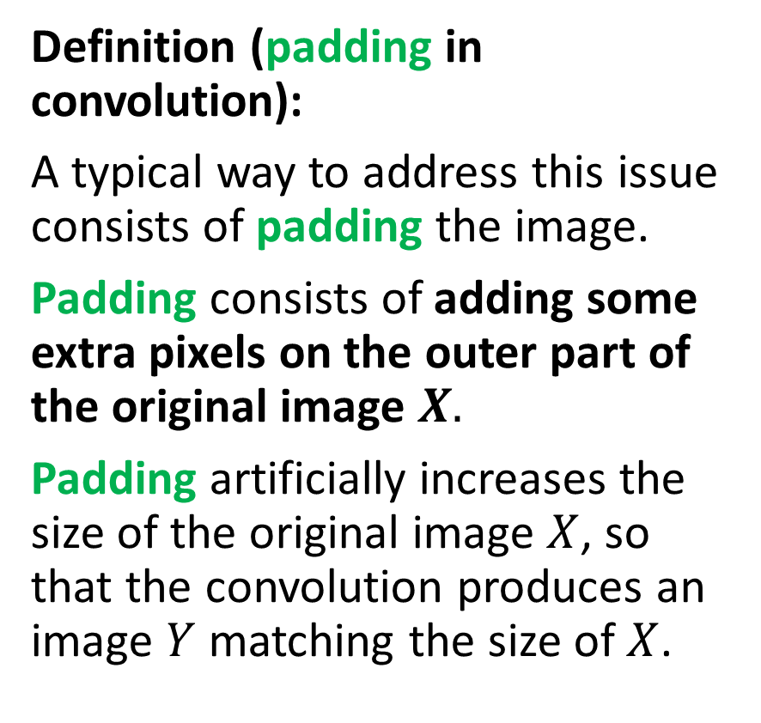
Adding some padding
Definition (padding in convolution):
A typical way to address this issue consists of padding the image.
Padding consists of adding some extra pixels on the outer part of the original image $X.$
Padding artificially increases the size of the original image $X$, so that the convolution produces an image $Y$ matching the size of $X$.
Three possible patterns for padding exist:
Valid/Same padding,
Zero padding,
Other types of padding…
This is typically be used to maintain the spatial dimensions of the input image and prevent the spatial dimensions of the output from getting too small.

Slide 45


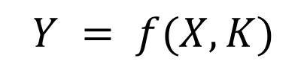

Adding some padding
Valid padding: default configuration, no padding is applied to the input data. The convolution operation is only performed only on the valid parts of the input and the output size is then smaller than the input size.
$$Y = f(X, K)$$
$$K$$
$$Y$$
$$X$$

Slide 46
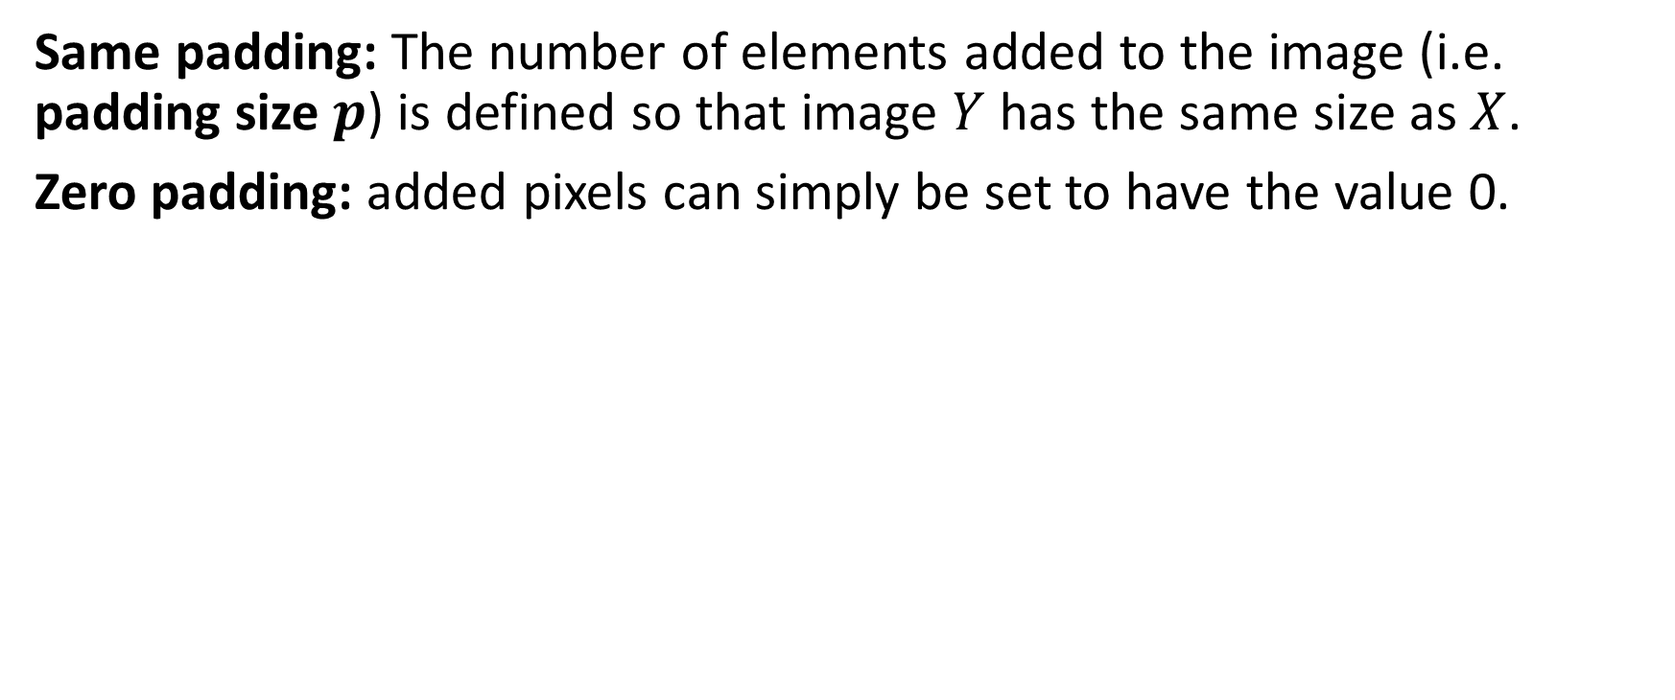
Adding some padding
Same padding: The number of elements added to the image (i.e. padding size $p$) is defined so that image $Y$ has the same size as $X$.
Zero padding: added pixels can simply be set to have the value 0.
0 | 0 | 0 | 0 | 0 | 0 | 0
0 |  |  |  |  |  | 0
0 |  |  |  |  |  | 0
0 |  |  |  |  |  | 0
0 |  |  |  |  |  | 0
0 |  |  |  |  |  | 0
0 | 0 | 0 | 0 | 0 | 0 | 0
$$Y = f(X, K)$$
$$K$$
$$Y$$
$$X$$

Slide 47
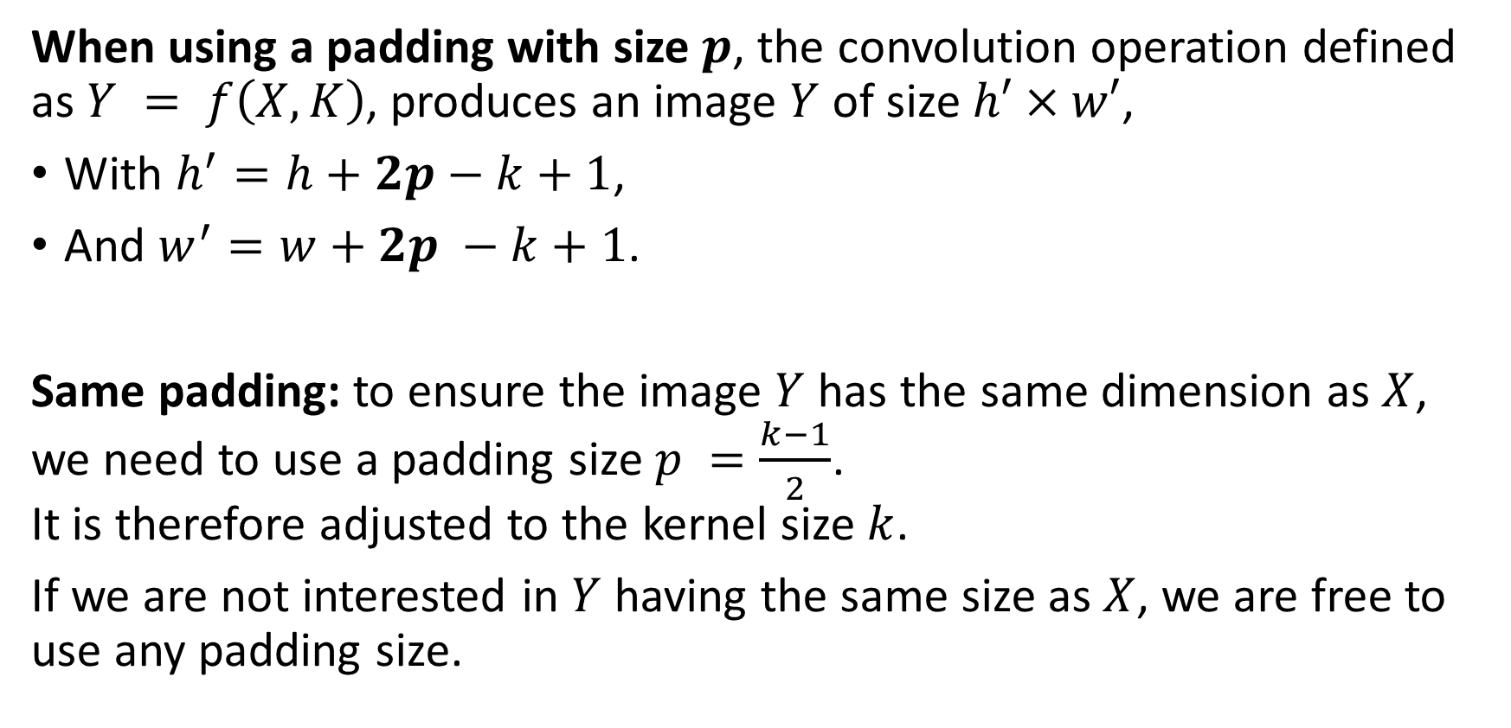
Adding some padding
When using a padding with size $p$, the convolution operation defined as $Y = f\left(X, K\right)$, produces an image $Y$ of size $h′×w′$,
With $h^{′}=h+2p−k+1$,
And $w^{′}=w+2p −k+1$.
Same padding: to ensure the image $Y$ has the same dimension as $X$, we need to use a padding size $p =\frac{k−1}{2}$. It is therefore adjusted to the kernel size $k$.
If we are not interested in $Y$ having the same size as $X$, we are free to use any padding size.

Slide 48
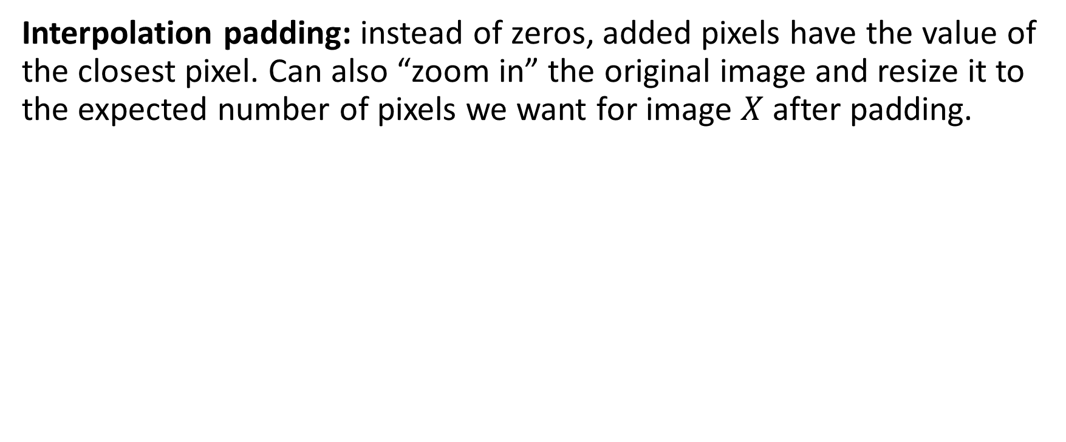
Adding some padding
Interpolation padding: instead of zeros, added pixels have the value of the closest pixel. Can also “zoom in” the original image and resize it to the expected number of pixels we want for image $X$ after padding.
1 | 1 | 5 | 5 | 2 | 4 | 4
1 | 1 | 5 | 5 | 2 | 4 | 4
2 | 2 | 4 | 5 | 2 | 2 | 2
3 | 3 | 1 | 1 | 1 | 1 | 1
4 | 4 | 4 | 7 | 2 | 3 | 3
5 | 5 | 0 | 0 | 3 | 1 | 1
5 | 5 | 0 | 0 | 0 | 1 | 1
$$Y = f(X, K)$$
$$K$$
$$Y$$
$$X$$

Slide 49
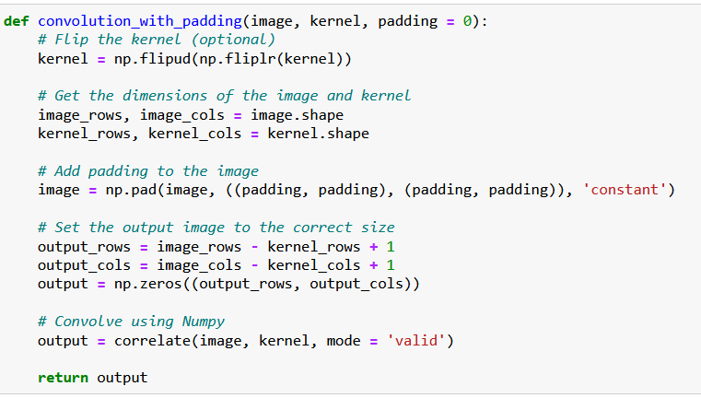
Adding some padding
0 | 0 | 0 | 0 | 0 | 0 | 0
0 |  |  |  |  |  | 0
0 |  |  |  |  |  | 0
0 |  |  |  |  |  | 0
0 |  |  |  |  |  | 0
0 |  |  |  |  |  | 0
0 | 0 | 0 | 0 | 0 | 0 | 0
Padding is simply implemented using the pad() function.
It adds a layer of zeroes to the matrix image, of size padding on top, bottom, right and left side of the image matrix.

Slide 50
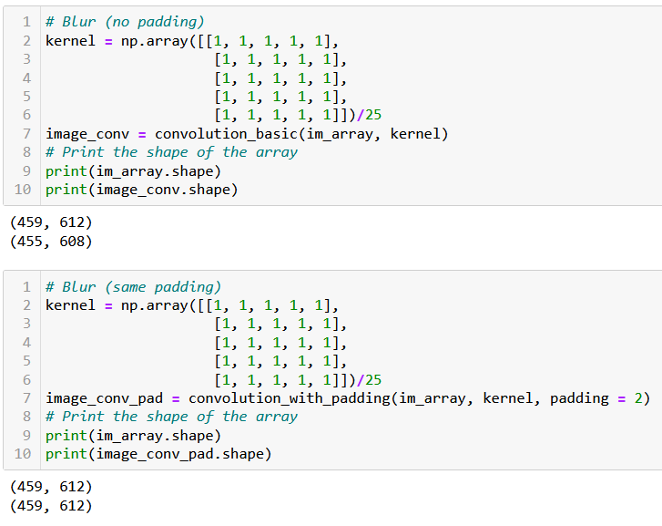
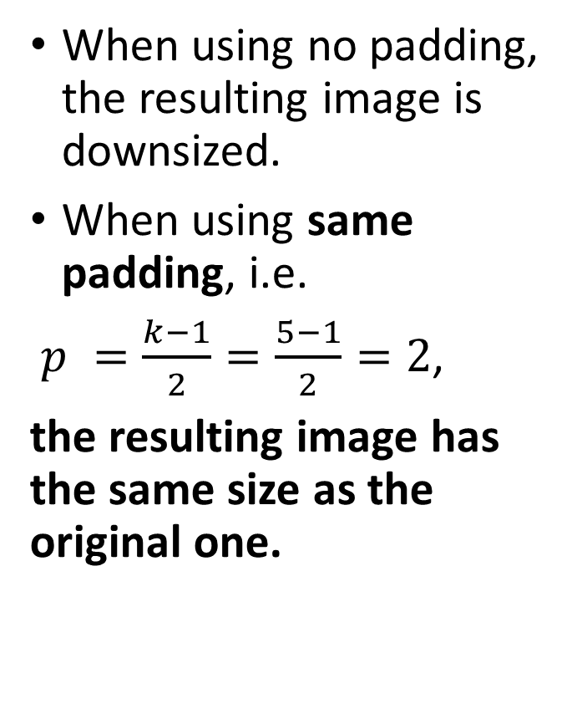
Adding some padding
When using no padding, the resulting image is downsized.
When using same padding, i.e.
$p =\frac{k−1}{2}=\frac{5−1}{2}=2$,
the resulting image has the same size as the original one.

Slide 51
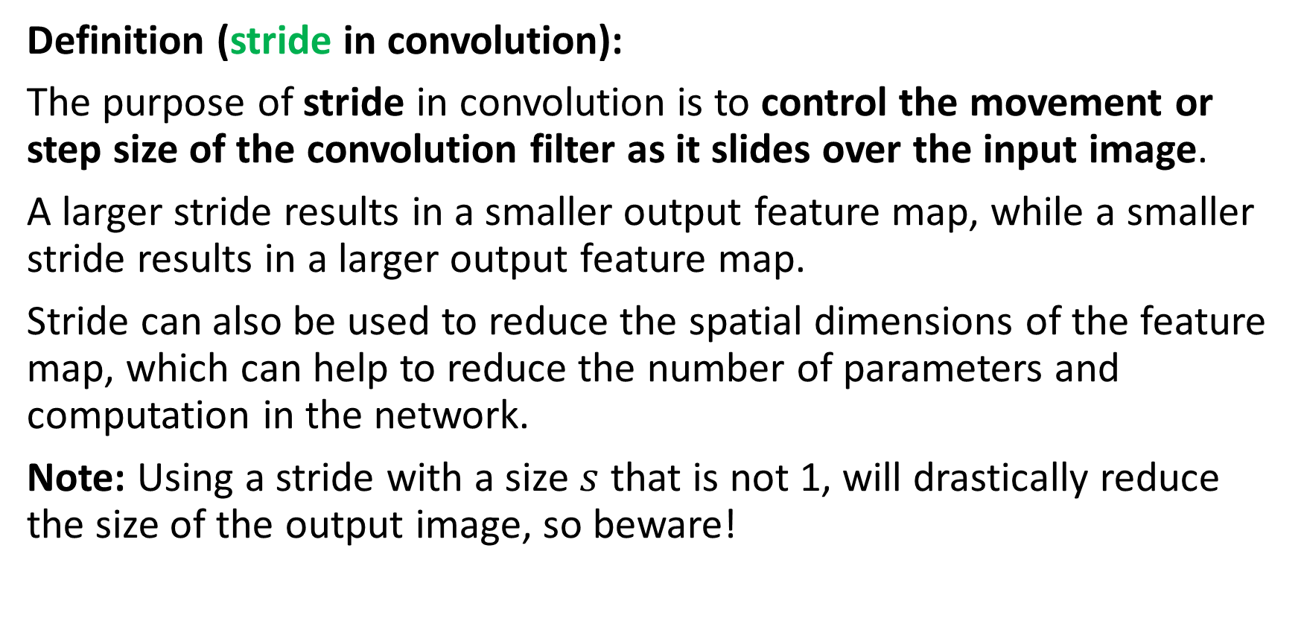
Adding a stride
Definition (stride in convolution):
The purpose of stride in convolution is to control the movement or step size of the convolution filter as it slides over the input image.
A larger stride results in a smaller output feature map, while a smaller stride results in a larger output feature map.
Stride can also be used to reduce the spatial dimensions of the feature map, which can help to reduce the number of parameters and computation in the network.
Note: Using a stride with a size $s$ that is not 1, will drastically reduce the size of the output image, so beware!

Slide 52
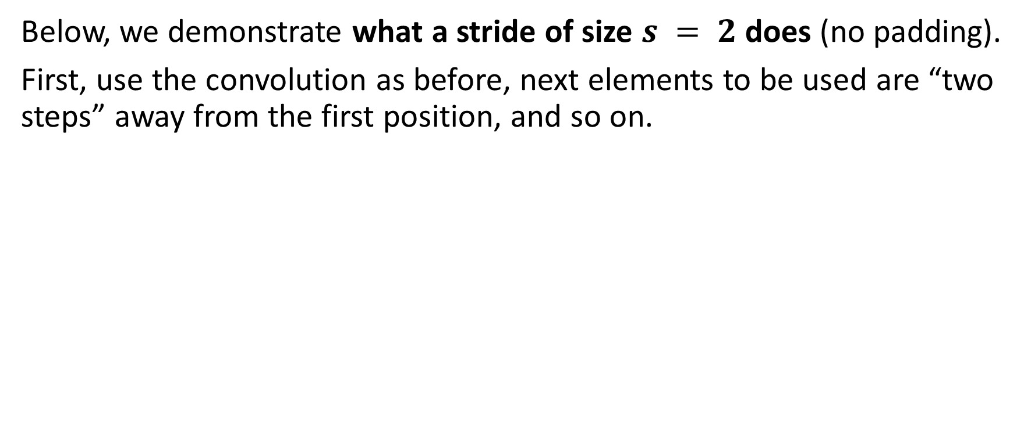
Adding a stride
Below, we demonstrate what a stride of size $s = 2$does (no padding).
First, use the convolution as before, next elements to be used are “two steps” away from the first position, and so on.
1 | 1 | 5 | 5 | 2 | 4 | 4
1 | 1 | 5 | 5 | 2 | 4 | 4
2 | 2 | 4 | 5 | 2 | 2 | 2
3 | 3 | 1 | 1 | 1 | 1 | 1
4 | 4 | 4 | 7 | 2 | 3 | 3
5 | 5 | 0 | 0 | 3 | 1 | 1
5 | 5 | 0 | 0 | 0 | 1 | 1
…
$$Y = f(X, K)$$
$$K$$
$$Y$$
$$X$$

Slide 53
Adding a stride
Below, we demonstrate what a stride of size $s = 2$does (no padding).
First, use the convolution as before, next elements to be used are “two steps” away from the first position, and so on.
1 | 1 | 5 | 5 | 2 | 4 | 4
1 | 1 | 5 | 5 | 2 | 4 | 4
2 | 2 | 4 | 5 | 2 | 2 | 2
3 | 3 | 1 | 1 | 1 | 1 | 1
4 | 4 | 4 | 7 | 2 | 3 | 3
5 | 5 | 0 | 0 | 3 | 1 | 1
5 | 5 | 0 | 0 | 0 | 1 | 1
… | …
$$Y = f(X, K)$$
$$K$$
$$Y$$
$$X$$

Slide 54
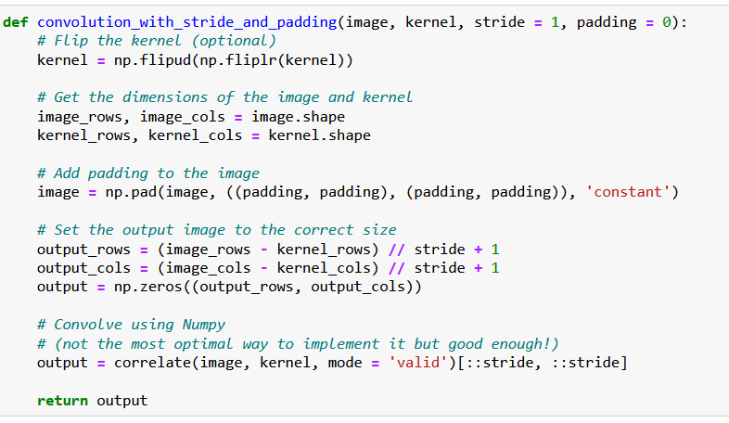
Adding a stride
Stride is easily implemented by using a slicing in the result of the correlation.
This is not the most optimized way to do it, however!
(We do not care so much, as we will use the PyTorch version of convolution after this!)

Slide 55
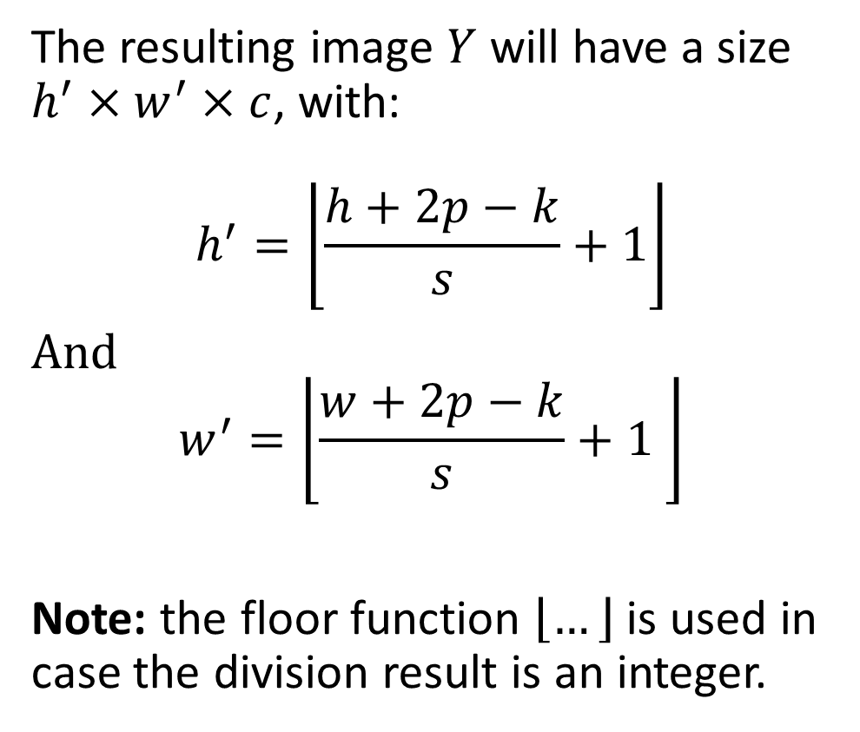
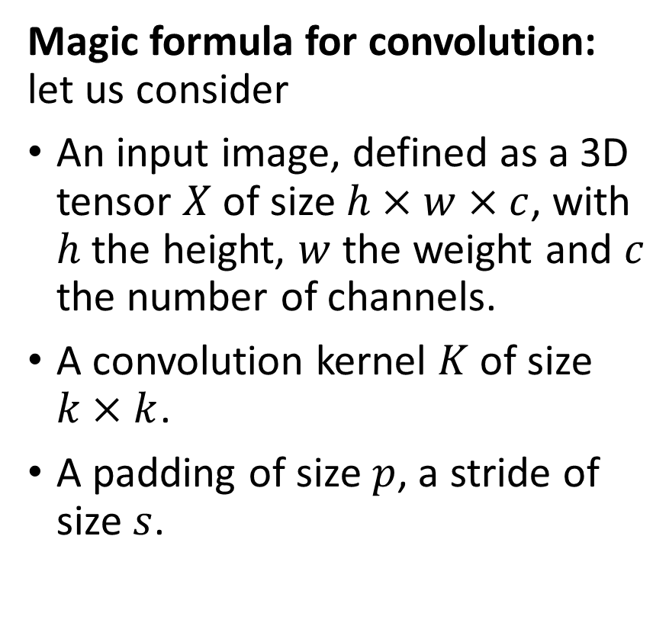
The (final) magic formula for convolution
Magic formula for convolution: let us consider
An input image, defined as a 3D tensor $X$ of size $h×w×c$, with $h$ the height, $w$ the weight and $c$ the number of channels.
A convolution kernel $K$ of size $k×k$.
A padding of size $p$, a stride of size $s$.
The resulting image $Y$ will have a size $h^{′}×w^{′}×c$, with:
$$h^{′}=\left\lfloor \frac{h+2p−k}{s}+1\right\rfloor$$
And $$w^{′}=\left\lfloor \frac{w+2p−k}{s}+1 \right\rfloor$$
Note: the floor function $\left\lfloor …\right\rfloor$ is used in case the division result is an integer.

Slide 56
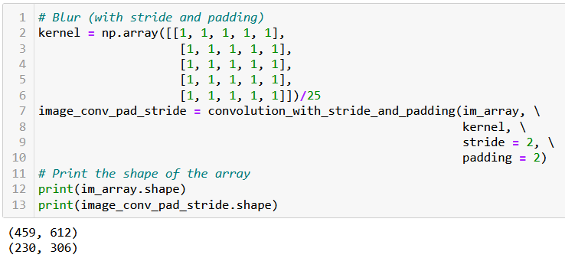
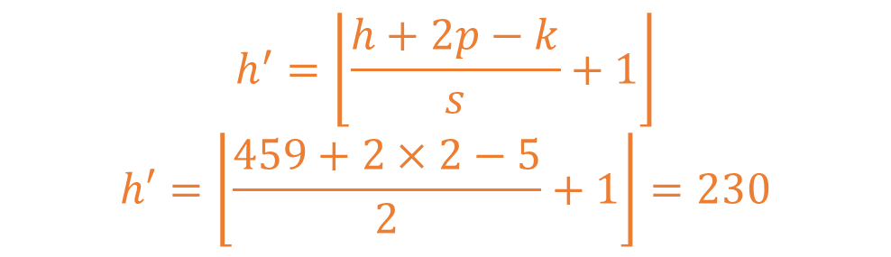
Adding a stride
$$h^{′}=\left\lfloor \frac{h+2p−k}{s}+1\right\rfloor$$
$$h′=\left\lfloor \frac{459+2×2−5}{2}+1\right\rfloor =230$$

Slide 57

Adding a dilation
Definition (dilation in convolution):
Dilation in image convolution determines the spacing between the values of the original image multiplying the kernel.
By default, the value for dilation is $d = 1.$
With a dilation greater than 1, the pixel values of the original image multiplying the kernel are spread apart by a specified number of pixels.
This is a very niche feature of the convolution operation. It is easier to visualise it than explain it.
(We leave its implementation as practice to the reader.)

Slide 58

Adding a dilation
Below, we demonstrate what a dilation of size $d = 2$does. Our convolution uses a stride with default value set to 1, padding is also set to its default value 0. Elements being computed together at then “2 steps away” from each other.
1 | 1 | 5 | 5 | 2 | 4 | 4
1 | 1 | 5 | 5 | 2 | 4 | 4
2 | 2 | 4 | 5 | 2 | 2 | 2
3 | 3 | 1 | 1 | 1 | 1 | 1
4 | 4 | 4 | 7 | 2 | 3 | 3
5 | 5 | 0 | 0 | 3 | 1 | 1
5 | 5 | 0 | 0 | 0 | 1 | 1
…
$$Y = f(X, K)$$
$$K$$
$$Y$$
$$X$$

Slide 59


The (final) magic formula for convolution
Magic formula for convolution version 2.0: let us consider
An input image, defined as a 3D tensor $X$ of size $h×w×c$, with $h$ the height, $w$ the weight and $c$ the number of channels.
A convolution kernel $K$ of size $k×k$.
A padding of size $p$, a stride of size $s$, and a dilation of size $d$.
The resulting image $Y$ will have a size $h^{′}×w^{′}×c$, with:
$$h^{′}=\left\lfloor \frac{h+2p−d\left(k−1\right)−1}{s}+1\right\rfloor$$
And $$w^{′}=\left\lfloor \frac{w+2p−d\left(k−1\right)−1}{s}+1 \right\rfloor$$
Note: the floor function $\left\lfloor …\right\rfloor$ is used in case the division result is an integer.

Slide 60

Implementing a custom Conv in PyTorch (with stride and padding, no dilation)

Slide 61

Implementing a custom Conv in PyTorch (with stride and padding, no dilation)
The PyTorch and the Numpy implementations are indeed equivalent.

Slide 62

The Conv2d in PyTorch
PyTorch has a Conv2d function implementing said convolution.
We will rely on it from now on.

Slide 63
The Conv2d in PyTorch
Note, however that this layer has two trainable parameters:
Weight (which is our kernel, whose values will be decided later during training).
Bias (which was not there before?)

Slide 64

The Conv2d in PyTorch
Note, however that this layer has two trainable parameters:
Weight (which is our kernel, whose values will be decided later during training).
Bias (which was not there before?)
Bias is simply added to our convolution operation, following the intuition of the $WX + b$operation from earlier.
$$Y_{i,j}=\frac{1}{k^{2}}\sum_{m=1}^{k}{\sum_{n=1}^{k}{X_{i+m−1, j+n−1} K_{m,n}}}+b$$

Slide 65
Let us call it a break for now
We will continue on the next lecture with our PyTorch implementation of the convolution operation and our first Convolutional Neural Network.

